Slide 1

The Unity platform

Slide 2

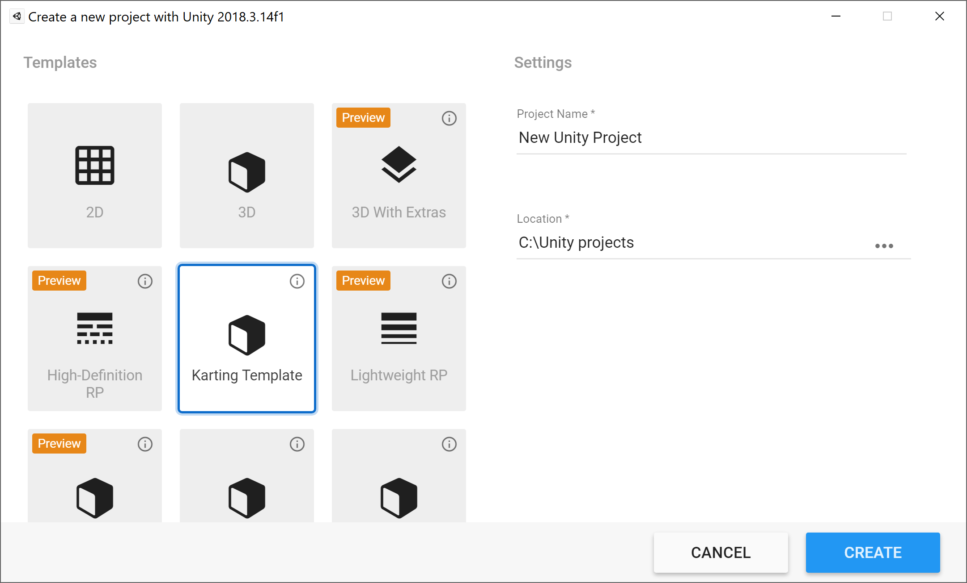
Installing Unity
If you haven’t had a chance to do so yet, install Unity
Follow the instructions available here: https://schoolofgames.github.io/DPIWorkshop.html
Make sure to install Unity version 2018.3.14f1
We will be available to help you if you need any assistance
Once you have installed Unity
Create a project using the Karting template
Follow the simple tutorial
Explore the Unity tool

Slide 3
Unity
What was your first impression of using Unity?
What was intuitive?
What was confusing?
What would you like to learn more about?
Let’s take a look at Unity together

Slide 4
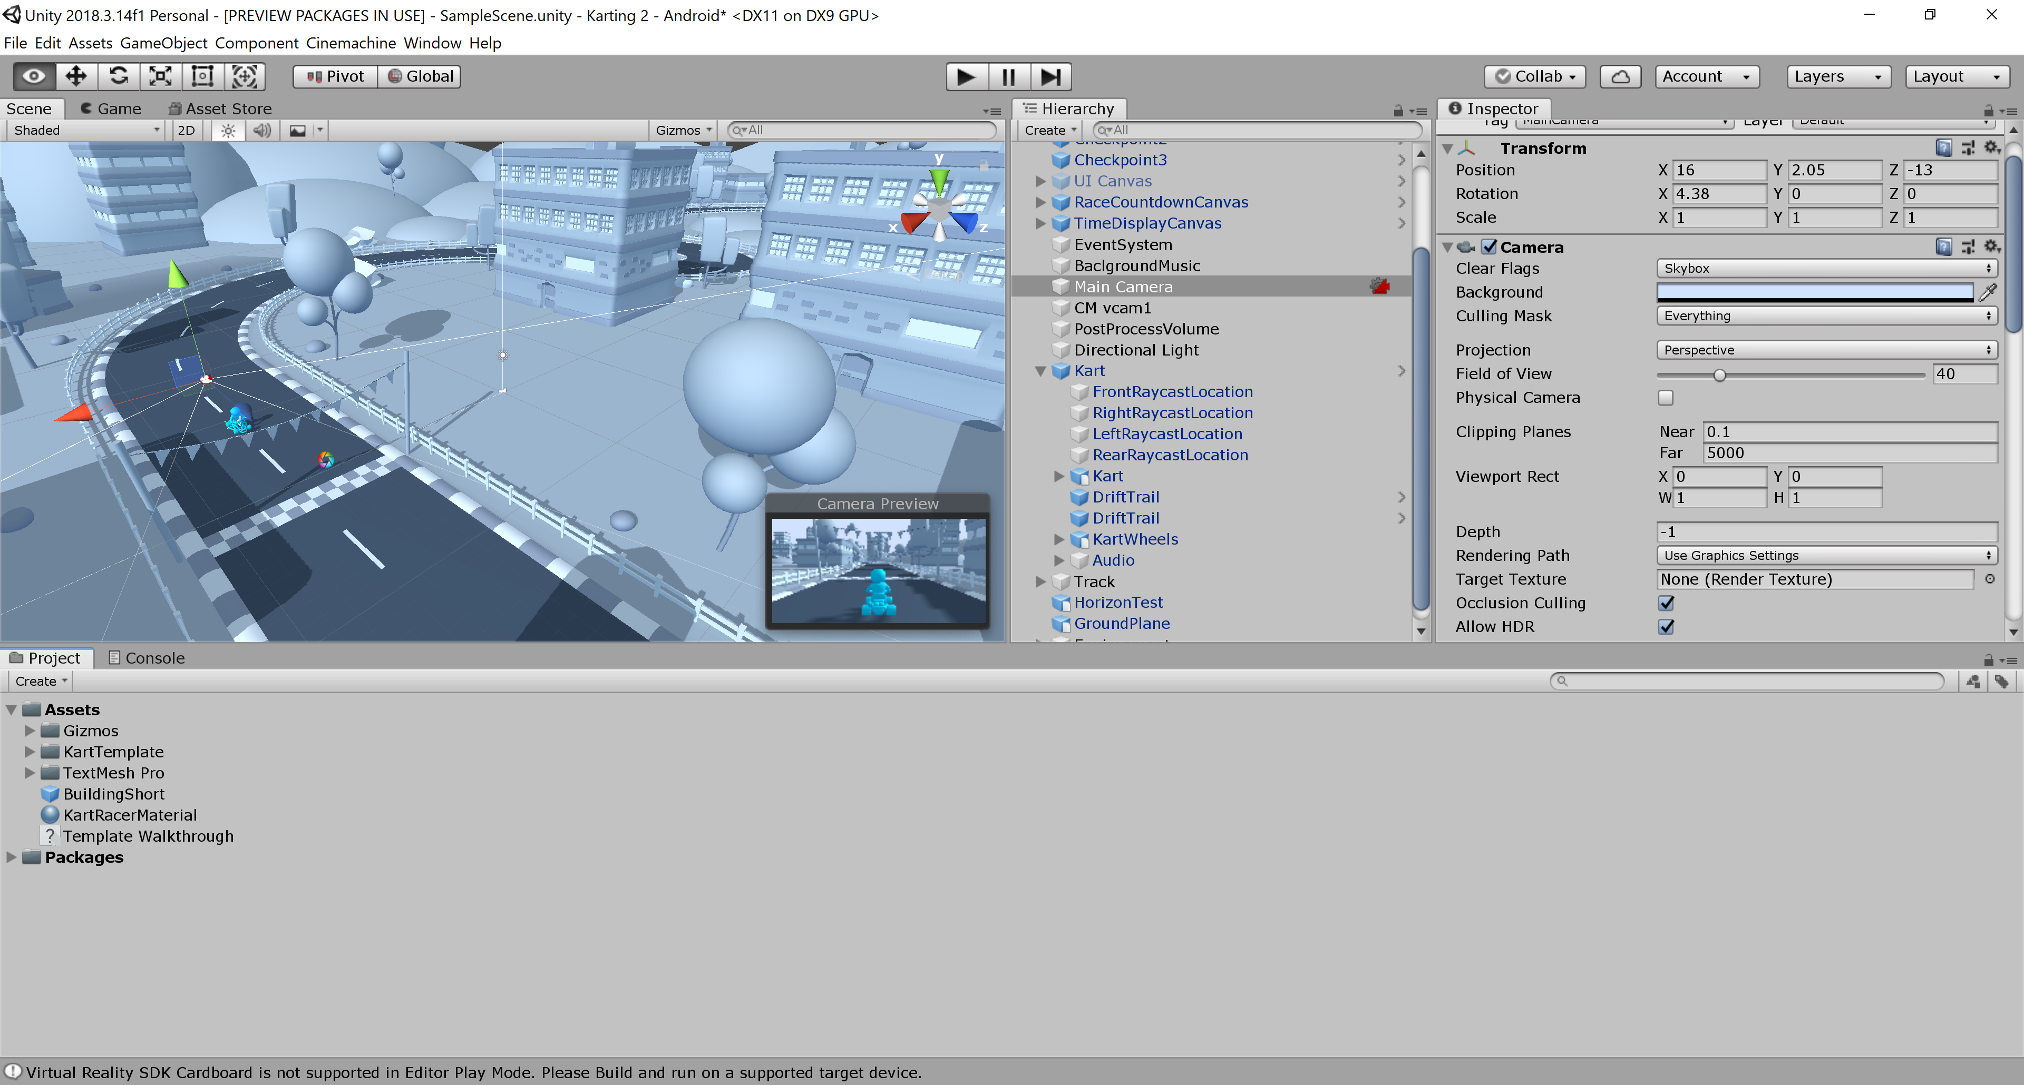
Unity
Unity is composed of a set of different windows
Each providing a different perspective/different tools to work on your project

Slide 5
Unity main loop
Scenes contain the environments and menus of your game.
Think of each unique scene as a unique level in a game
A scene is composed of Game objects
The behavior of a game object is determined by its Components

Slide 6
Unity main loop
When the game is running, Unity goes through all the objects in the scene and updates them according to the components assigned to them
A camera (a game object) is used to capture the visual representation of the scene that the player will see
From this camera’s perspective

Slide 7
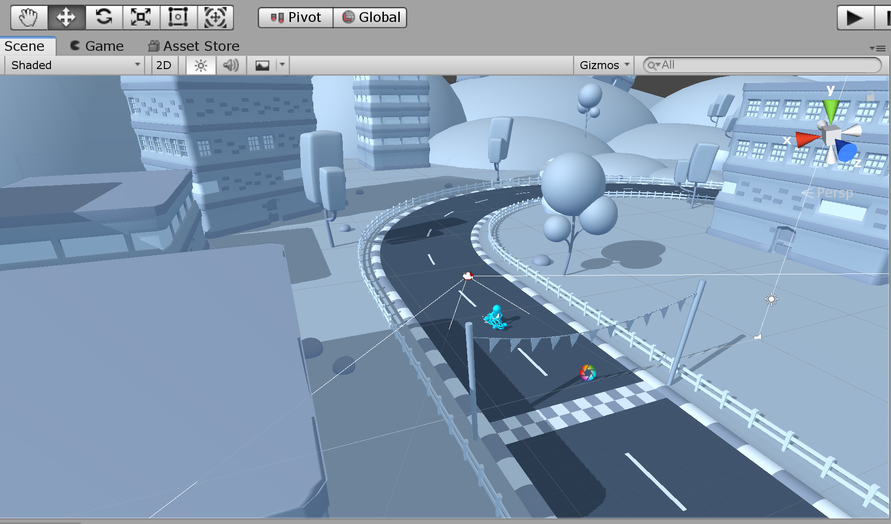
Scene view
Allows you to visualize your scene and interact with the game objects in contains

Slide 8
Scene view
Use the hand tool to navigate the scene (using the ALT key allows you to rotate your perspective)

Slide 9
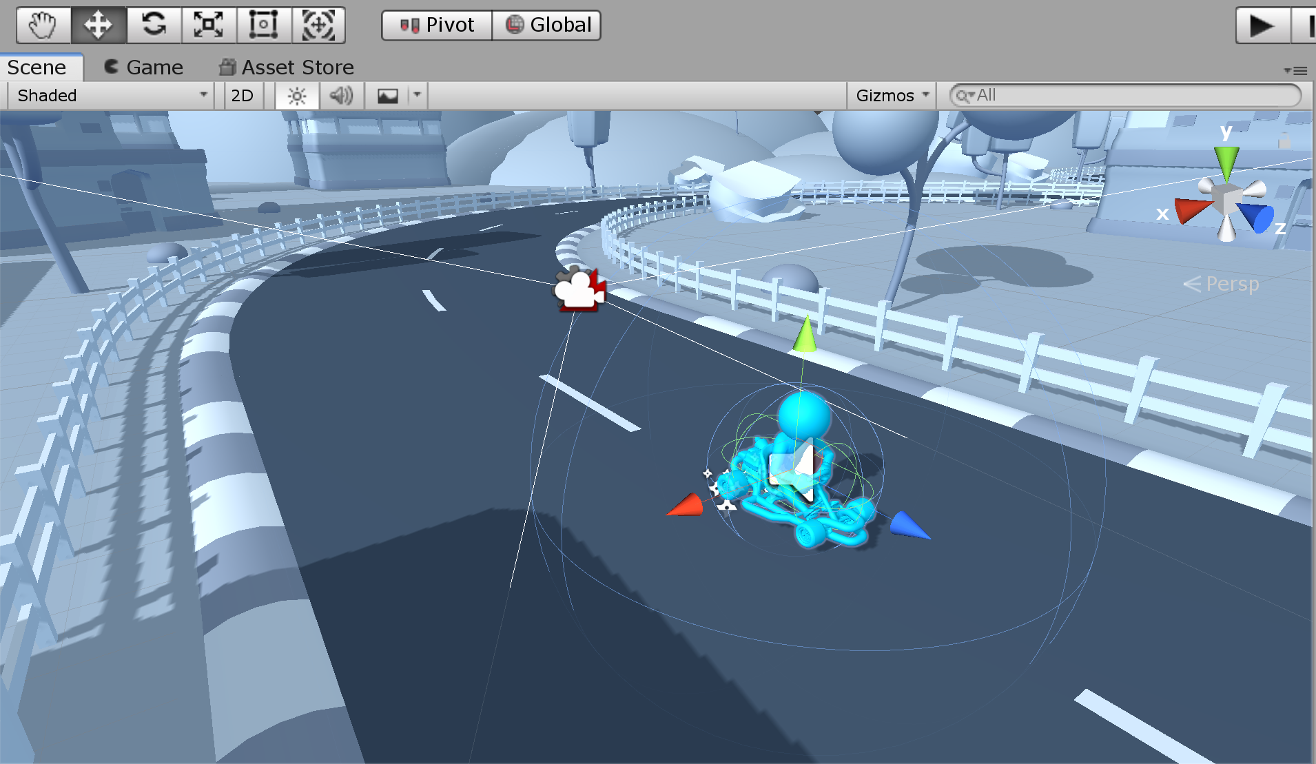
Scene view
When an object in the scene is selected, the move, rotate and scale tools can be used to edit the object in the scene. (interactable widgets will be displayed on the object)

Slide 10
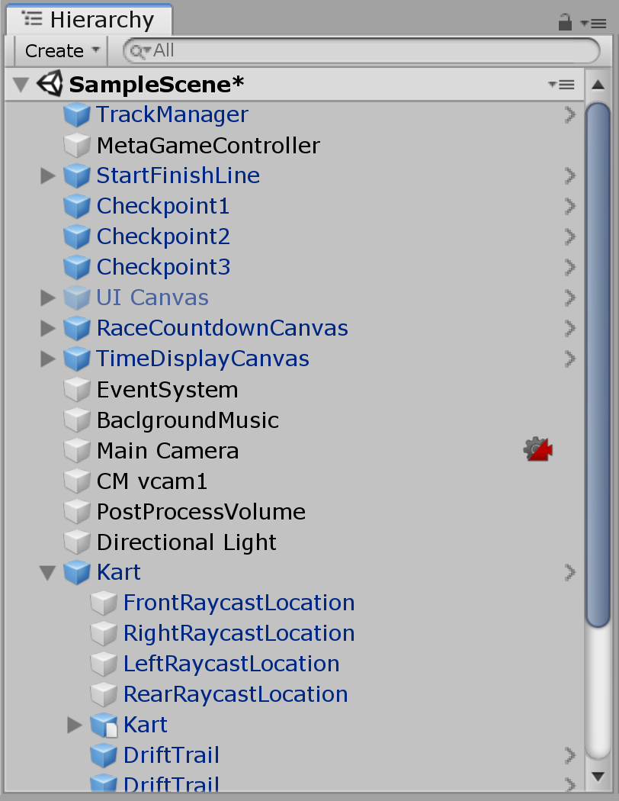
Objects hierarchy
The hierarchy window presents information about all the objects included in the scene
Objects can be nested
i.e., a game object can be defined as the combination of multiple game objects

Slide 11
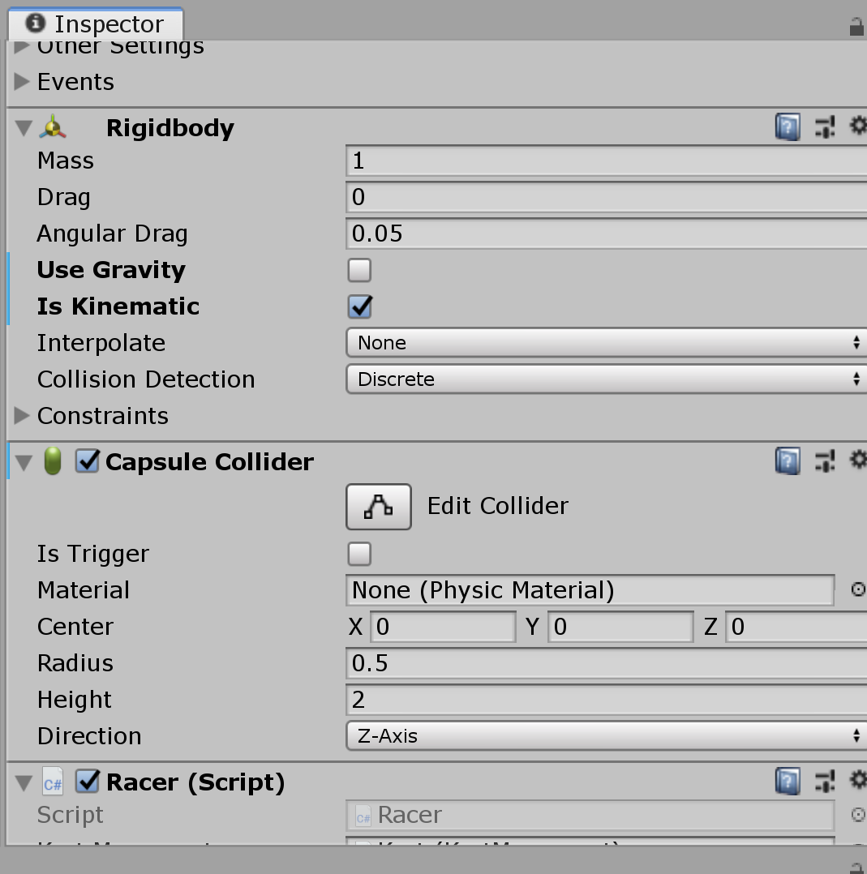
Inspector
When a game object is selected, the inspector window will show its detailed properties
Those properties can be edited to change the object’s behavior
The inspector will show all the components that are associated with that game object
Components can be added and removed from the inspector window

Slide 12
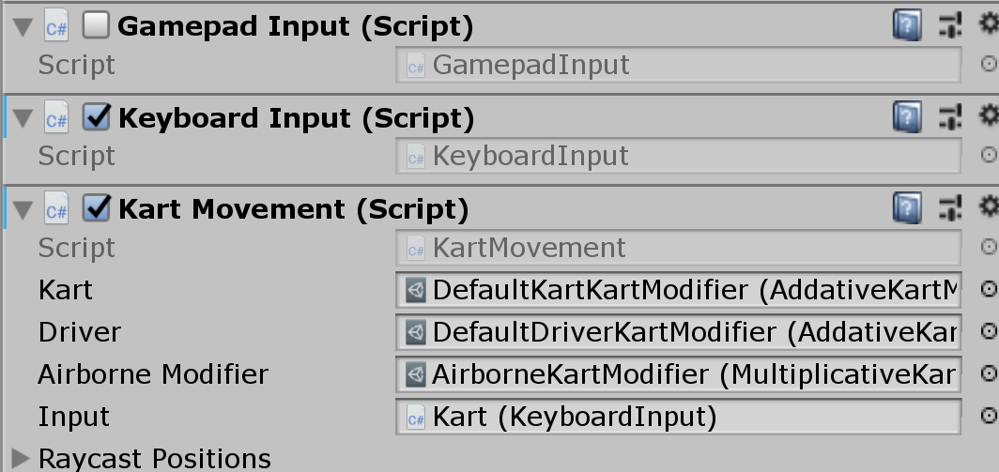
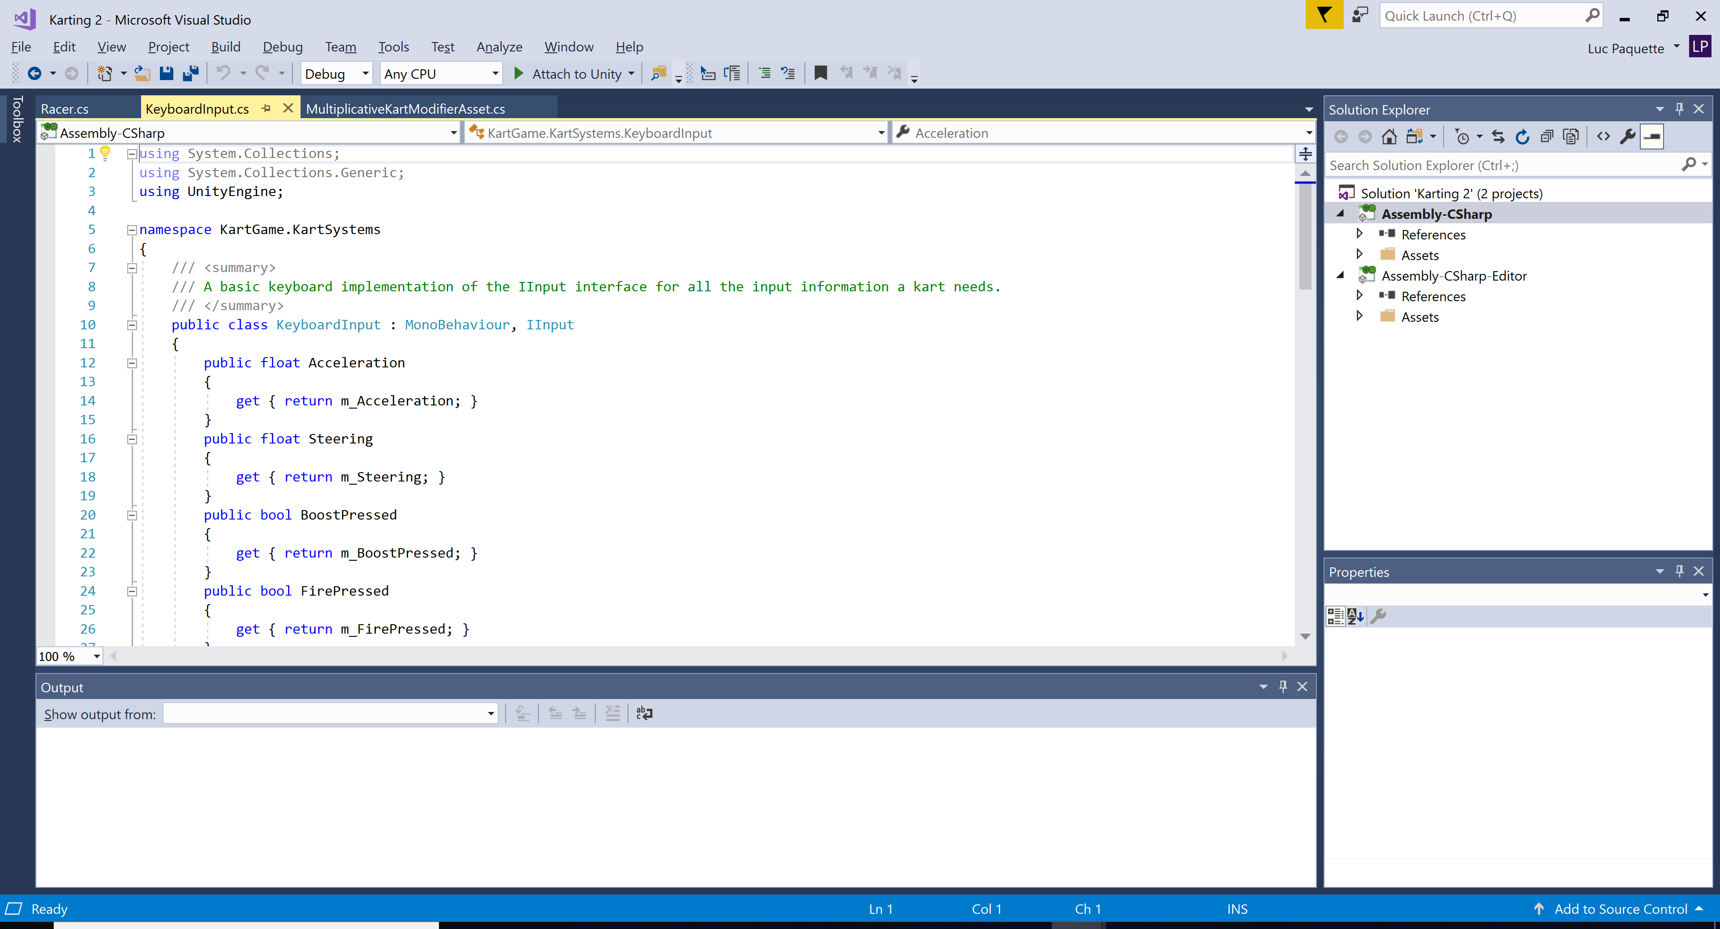
Scripts
Some components will have scripts associated with them
Scripts are pieces of code used to control the game object’s behavior
Double clicking on a script will open it in a code editor

Slide 13
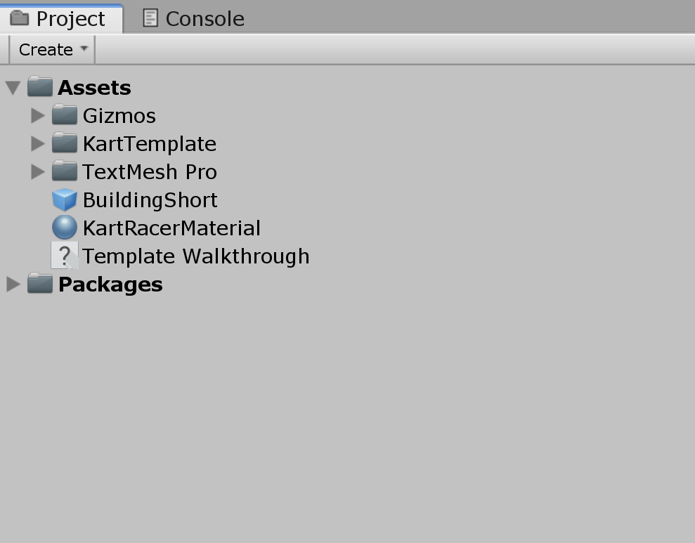
Project
The project windows contains all the assets that are currently available to build your scenes (including the scenes themselves)
3D models
Scripts
Scenes
Etc.

Slide 14
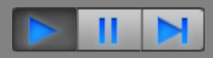
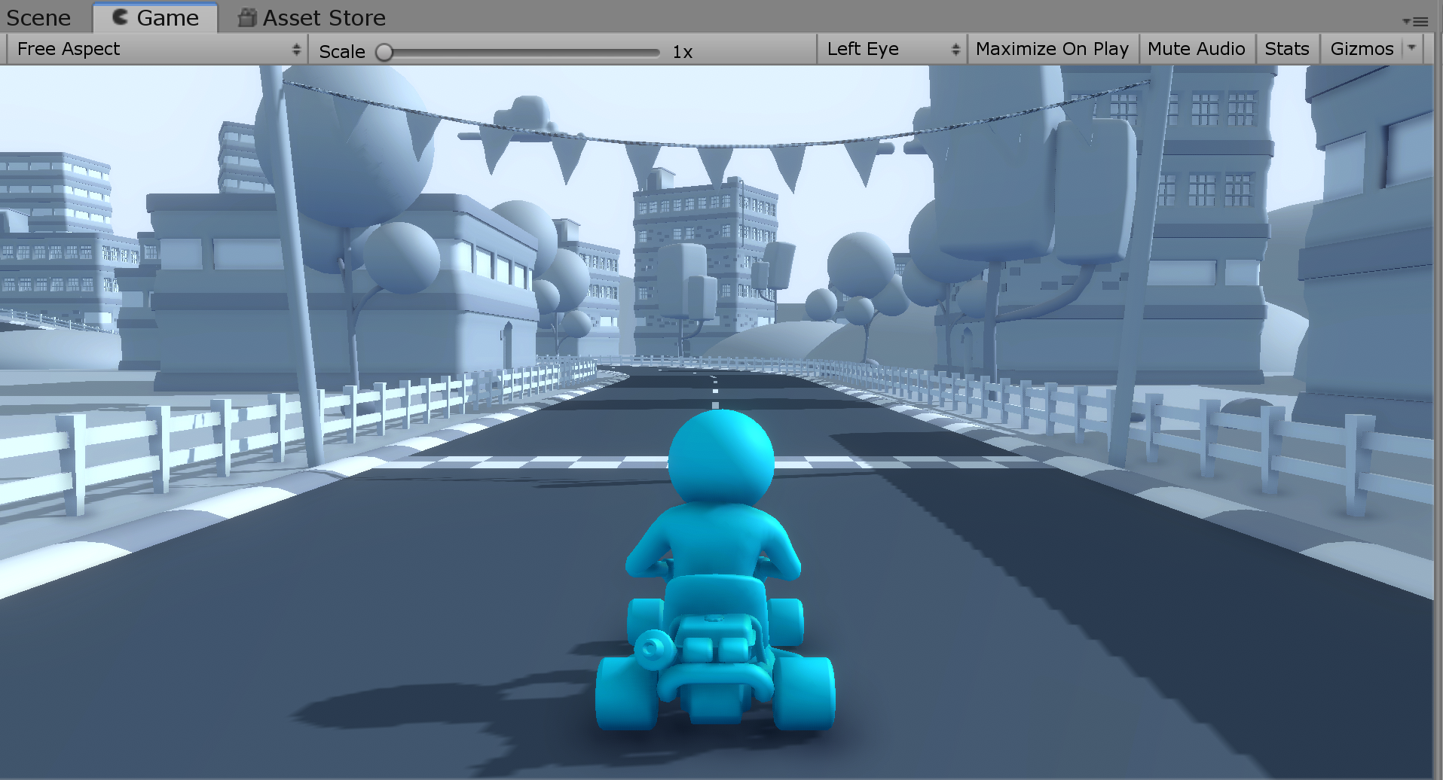
Game view
The Play, Pause and Step buttons can be used to run your game
While the game is running, the game view shows the player’s perspective

